Slide 1
ASSIGNMENT -
CUSTOMERS OF AN ONLINE SALES CHANNEL
PAWAR BHARATH

Slide 2
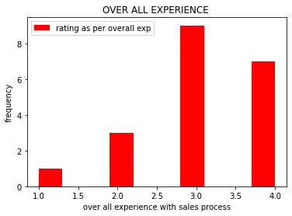
CURRENT STATE OF CUSTOMER SATISFACTION ?
we can see that irrespective of customer segement we have got feedback for overall experience of maximum 3 stars.
Tier1: 2 Customers have rated less than 3 stars .
10 percent of customers in tier1 have given feedback less than 3 stars i.e(1,2).
Tier2: No customer has rated less than 3 stars.
100 percent of customers in tier2 has given feedback above 3 stars i.e (4)
Tier3: 2 people has rated less than 3 stars.
10 percent of customers in tier3 has given feedback below 3 stars.

Slide 3
CUSTOMER SATISFACTION
BI VARIATE ANALYSIS FOR COMBINATION OF ALL CATAGORIES
BI VARIATE ANALYSIS FOR T1 CATAGORY
BI VARIATE ANALYSIS FOR T2 CATAGORY
BI VARIATE ANALYSIS FOR T1 CATAGORY

Slide 4
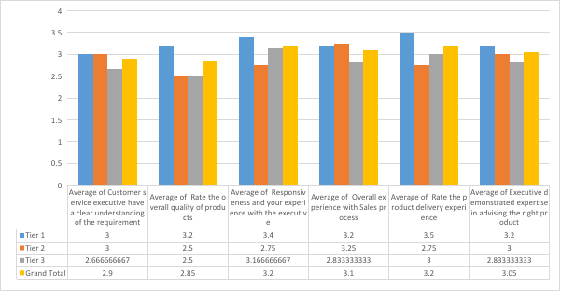
OVER VIEW OF BI VARIATE ANALYSIS VERSES CATAGORIES .

Slide 5
CUSTOMER SATISFACTION IRRESPECTIVE OF CATAGORIES ?
Customer service executive have a clear understanding of the requirement: 72.5% of customer satisfaction.
Rate the overall quality of products: 71.25% of customer satisfaction.
Rate the product delivery experience: 80% of customer satisfaction.
Responsiveness and your experience with the executive: 80% of customer satisfaction.
Executive demonstrated expertise in advising the right product: 76.25% of customer satisfaction.
Overall experience with Sales process: 77.5% of customer satisfaction.

Slide 6
BI VARIATE ANALYSIS FOR T1 CATAGORY
Customer service executive have a clear understanding of the requirement: 75% of customer satisfaction.
Rate the overall quality of products: 80% of customer satisfaction.
Rate the product delivery experience: 87.5% of customer satisfaction.
Responsiveness and your experience with the executive: 85% of customer satisfaction.
Executive demonstrated expertise in advising the right product: 80% of customer satisfaction.
Overall experience with Sales process: 80% of customer satisfaction.

Slide 7
BI VARIATE ANALYSIS FOR T2 CATAGORY
Customer service executive have a clear understanding of the requirement: 75% of customer satisfaction.
Rate the overall quality of products: 62.5% of customer satisfaction.
Rate the product delivery experience: 68.75% of customer satisfaction.
Responsiveness and your experience with the executive: 68.75% of customer satisfaction.
Executive demonstrated expertise in advising the right product: 75% of customer satisfaction.
Overall experience with Sales process: 81.25% of customer satisfaction.

Slide 8
BI VARIATE ANALYSIS FOR T3 CATAGORY
Customer service executive have a clear understanding of the requirement: 65% of customer satisfaction.
Rate the overall quality of products: 62.5% of customer satisfaction.
Rate the product delivery experience: 75% of customer satisfaction.
Responsiveness and your experience with the executive: 77.5% of customer satisfaction.
Executive demonstrated expertise in advising the right product: 70% of customer satisfaction.
Overall experience with Sales process: 70% of customer satisfaction.

Slide 9
DIFFERENT METHODS TO IMPROVE FEEDBACK GATHERING PROCESS ?
Get Feedback on Live Chat Session:Live chat can address many issues. For example,This feedback can include basic questions about whether the chat experience was helpful.
Call Your Customers Regularly:Calling customers is a highly personalized way to seek customer feedback. This method is proactive, and generates the best responses.
Use Email Surveys For New Customers:One of the best parts about email surveys is that you can seek information on the entire shopping experience, from search to shipment. It is a must for new shoppers.
Ask For Feedback On Order Confirmation Page:Your order confirmation page is ideal for seeking feedback about a customer’s online shopping experience
Ask Feedback Right After Purchase:Displaying a popup after finalizing the purchase can be really effective.
Ask Feedback When Your Visitor Tries To Abandon His Cart:Based on a study conducted by Baymard Institute, e-commerce sites face an abandonment rate of approximately 68 percent. Customer feedback at this stage plays a key role in improving conversions.
Provide Dedicated Customer Feedback Forms on Your Site:According to a survey, 54% of online shoppers preferred this method of interacting with customer service.

Slide 10
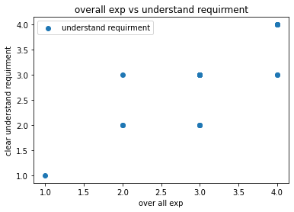
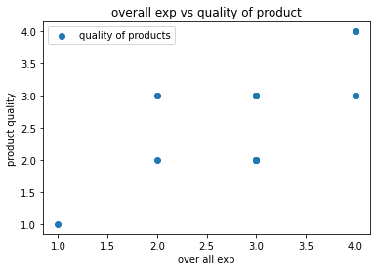
STEPS TAKEN TO IMPROVE THE EXPERIENCE?
overall sales experience increases when Customer service executive have a clear understanding of the requirement.
over all sales experience increases when product of quality is good .

Slide 11
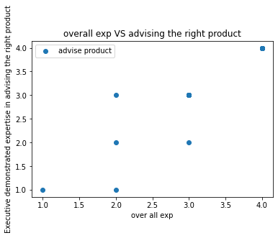
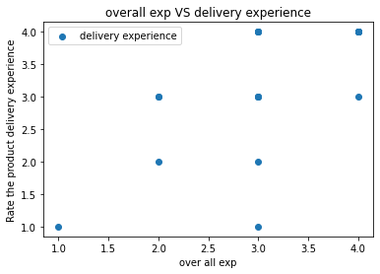
STEPS TAKEN TO IMPROVE THE EXPERIENCE?
If executive is advising proper product then our sales will increase,over all sales experience increases when correct product is advised .
Delivery experience improvement may result in better Overall experience with Sales process

Slide 12
ASSUMPTIONS
The scale of data 1-4 , 1 indicating the poor and 4 is excellent.
The sample of data provided for analysis is a representative data.
There are 4 ratings i.e 1,2,3,4 1 is 25%,2 is 50%,3 is 75%,4 is 100%.
Average of every column gives the percentage of customer satisfaction.
Average rating is 3 ,i.e is good rating.

Slide 13
FINDINGS
checking ratings :
less than 3 for Overall experience with Sales process found that;
TIER1: 10% of data lies
TIER2:100% of data lies for greater than 3 ,i.e 0% of data lies in less than 3.
TIER3:10% of data lies

Slide 14
CHALLENGES
The size of data sample is very small .A bigger size data may result to in depth analysis and better insight.
If at all we have large amount of data from feedback gathering methods then it could have helped to bring more insights .
To improve experience i.e we need to have large feed back data.
Better understanding of customers means more feedback data with different methods .

Slide 15
THANK YOU

